Slide 1

Microsoft Power Platform
Intelligent Automation Usergroup BS/WOB - #3

Slide 2
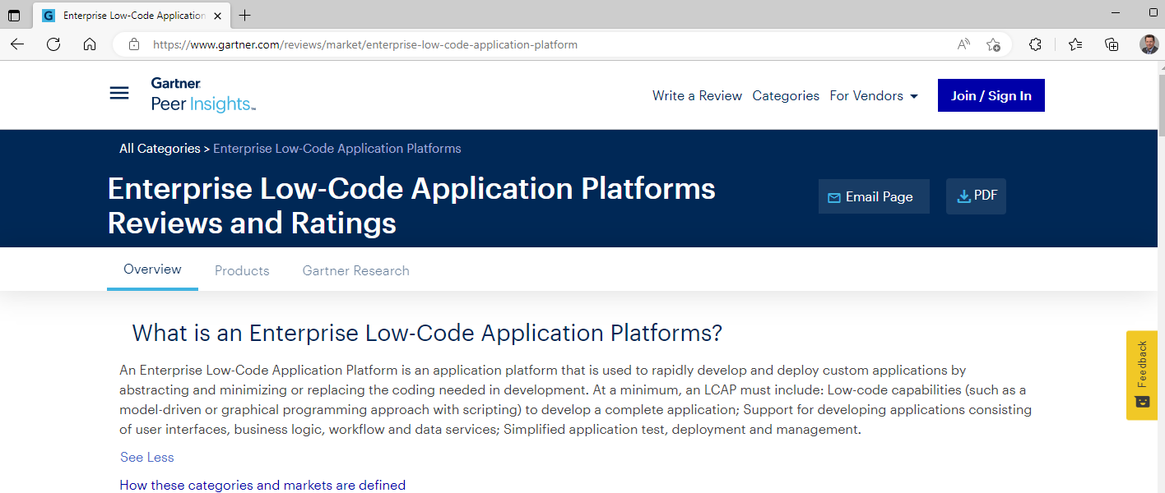
What is an Enterprise Low-Code Application Platform?
Notes:
Planned duration: 0:03
What is an Enterprise Low-Code Application Platform?
An Enterprise Low-Code Application Platform is an application platform that is used to rapidly develop and deploy custom applications by abstracting and minimizing or replacing the coding needed in development.
At a minimum, an LCAP must include: Low-code capabilities (such as a model-driven or graphical programming approach with scripting) to develop a complete application; Support for developing applications consisting of user interfaces, business logic, workflow and data services; Simplified application test, deployment and management.
https://www.gartner.com/reviews/market/enterprise-low-code-application-platform
In model-driven, low-code development, the model is a user-friendly veneer that encloses a pre-built application component (pieces of functionality). Each self-contained building block handles all the technical aspects of that component—from logic to user interface to the security and integration concerns—allowing them to operate together seamlessly. The result is a powerful drag-and-drop visual model of abstracted functionality that plays nicely with other components.
https://www.mendix.com/model-driven-development/

Slide 3
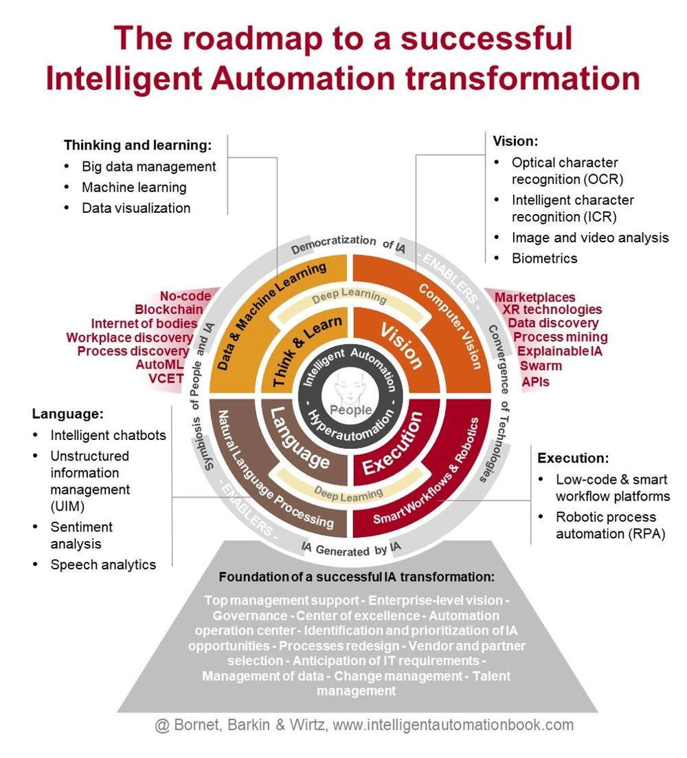
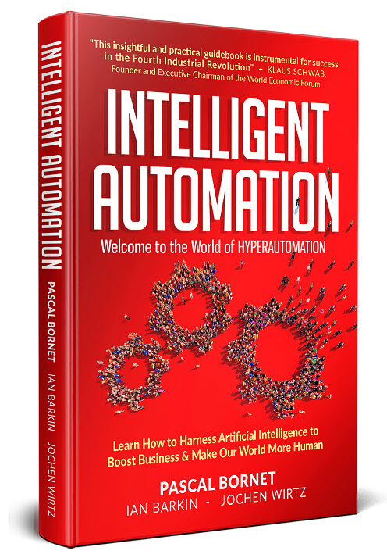
IA Execution: Smart Workflows, Low-Code platforms and RPA
Intelligent Automation Execution
The three key technologies supporting this capability include
smart workflow,
low-code platforms, and
robotic proces automation (RPA).
The leading practice is to use smart workflow and low-code platforms as a foundation of the overall automation platform. RPA is needed when IA needs to be integrated with legacy systems or automation of bespoke processes.
@see: https://intelligentautomationbook.com/
Notes:
Planned duration: 0:01 „Execution“ is defined as „about ‚doing‘, actually accomplishing step-by-step process tasks in digital environments (e.g., on computes or servers). Such activities include typing text, clicking on buttons, routing information, filling in forms, and authenticating users.“
„The three key technologies supporting this capability include smart workflow, low-code platforms, and robotic proces automation (RPA).“ „These technologies can be used interchageably. The leading practice is to use smart workflow and low-code platforms as a foundation of the overall automation platform. RPA is needed when IA needs to be integrated with legacy systems or automation of bespoke processes.“

Slide 4
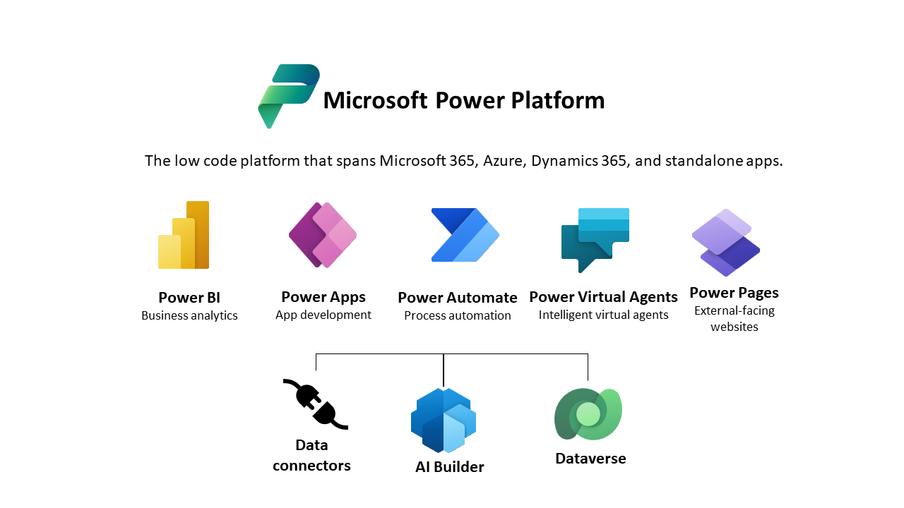
Components of the Microsoft Power Platform

Slide 5
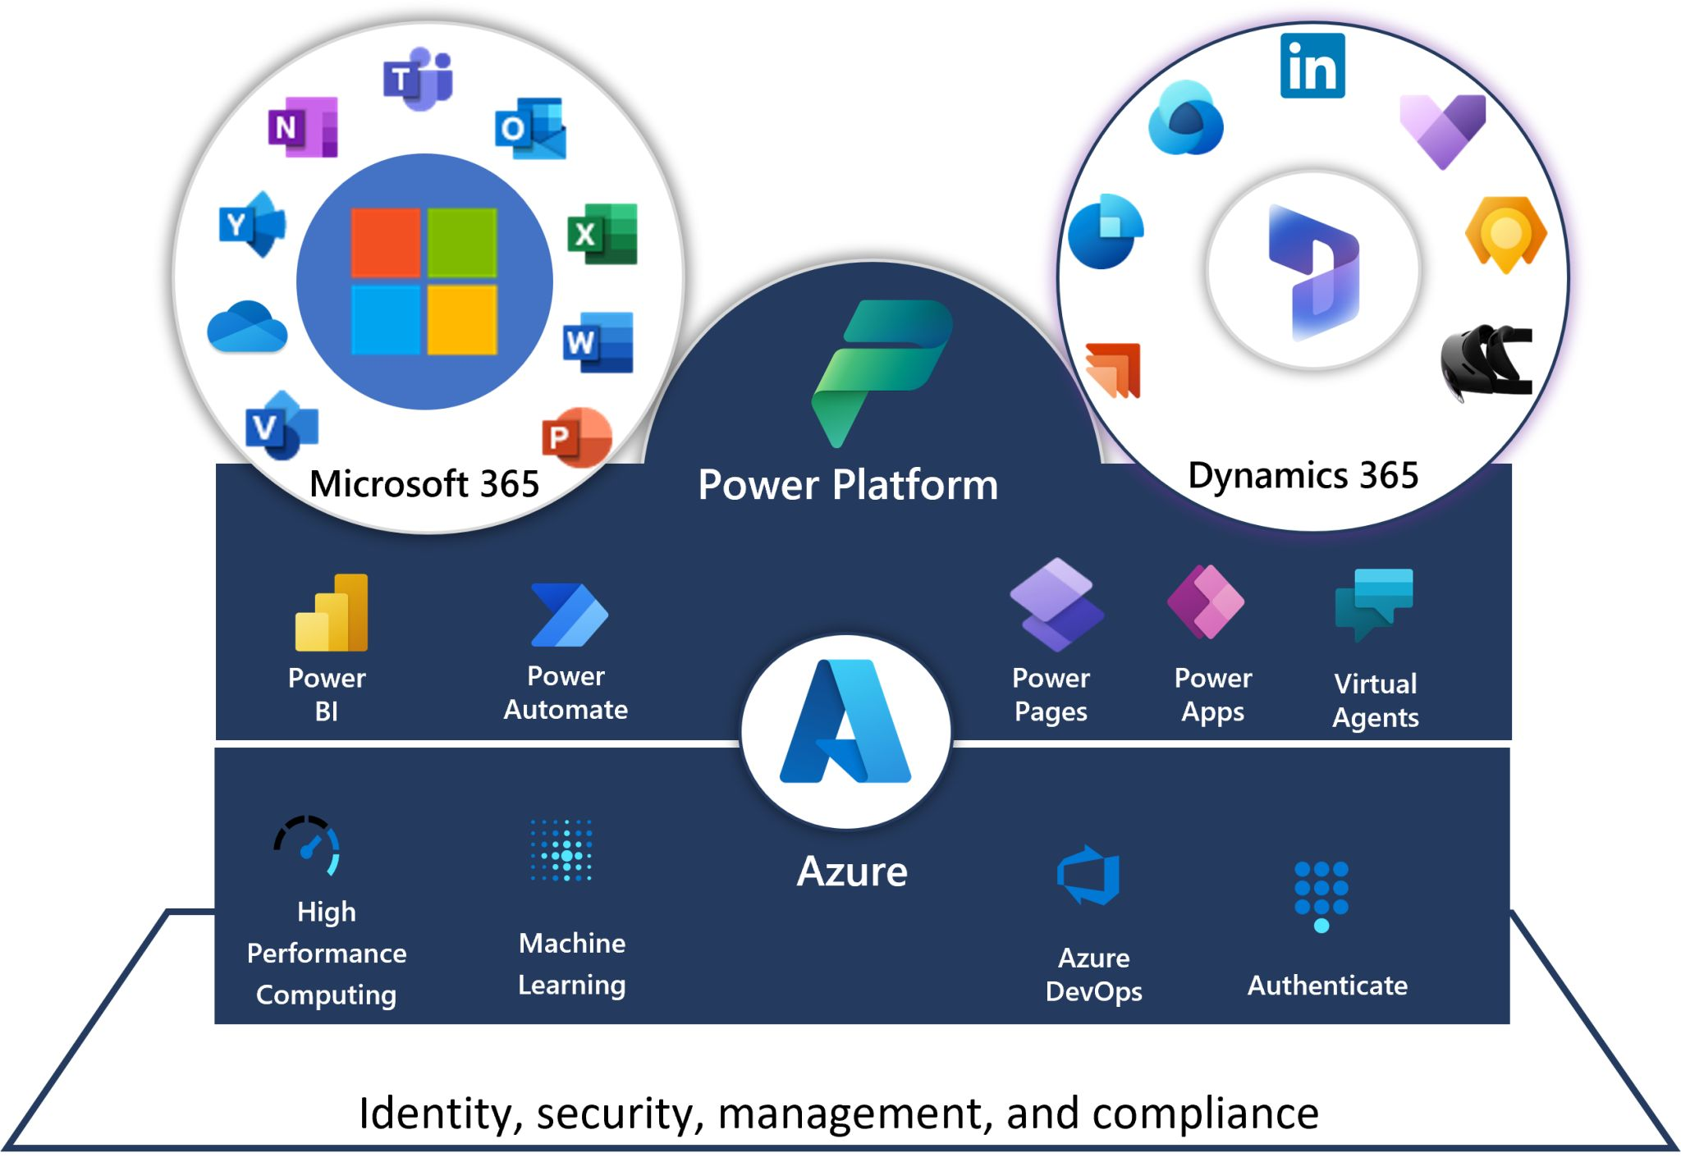
The Architecture of the MS Power Platform

Slide 6




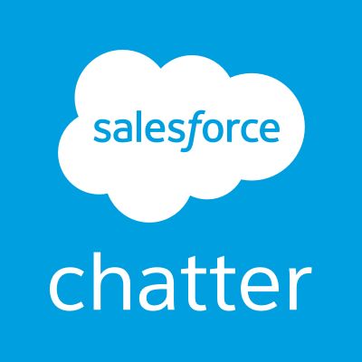




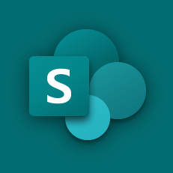
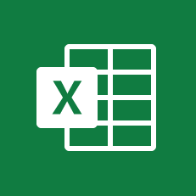




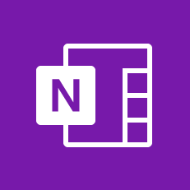
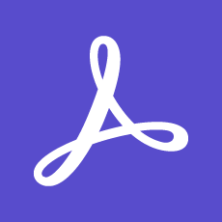
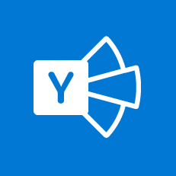
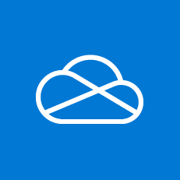
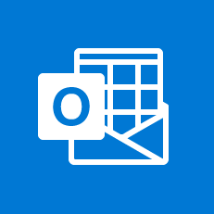
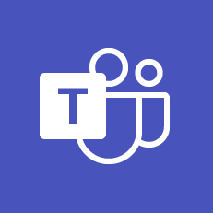
Connectors and Data Loss Prevention DLP
Business Data
Non-business Data
Blocked
Notes:
Planned duration: 0:01
The importance of BU-specific policies
DLP Polices is based on adding services / connectors to one out of three groups:
Business
Non-business
Blocked
If connector is in Business group, application and automatization can use ALL connectors from Business group ONLY. In such application or automatization where at least one connector is added from Business group the Non-business connectors cannot be used.
And vice versa if Non-business group connector is in use, then Business group connectors cannot be used.
Such setup is helping to prevent unwanted use of connectors.

Slide 7
Power Automate: Types of Flows
Cloud
Desktop
Business

Slide 8
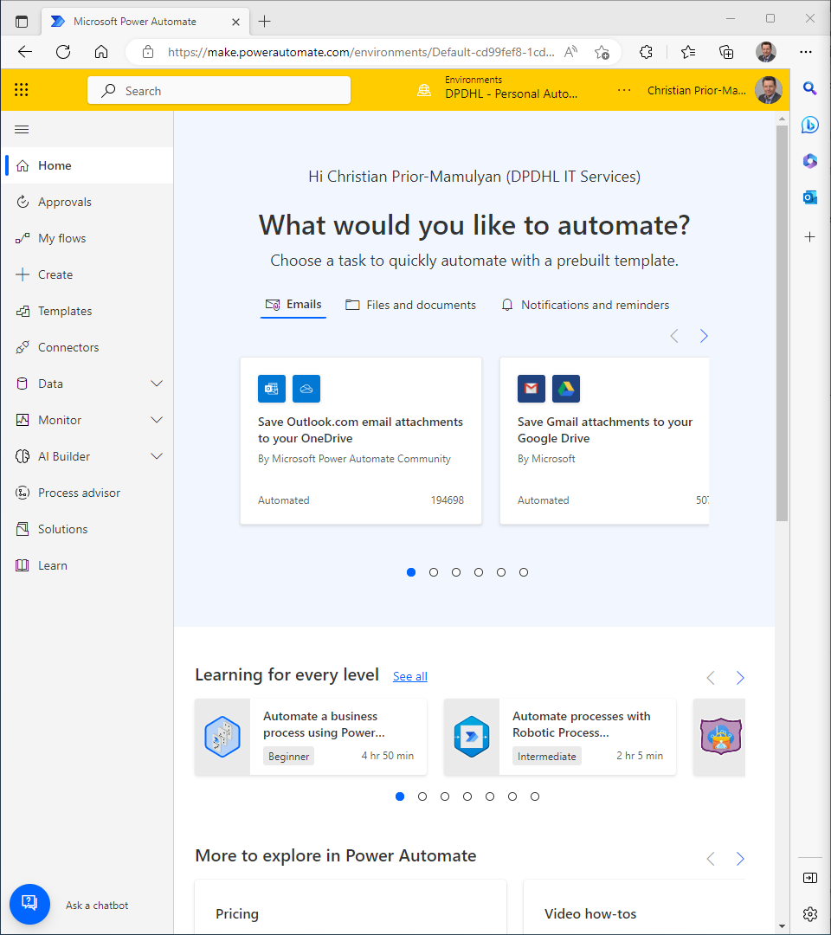
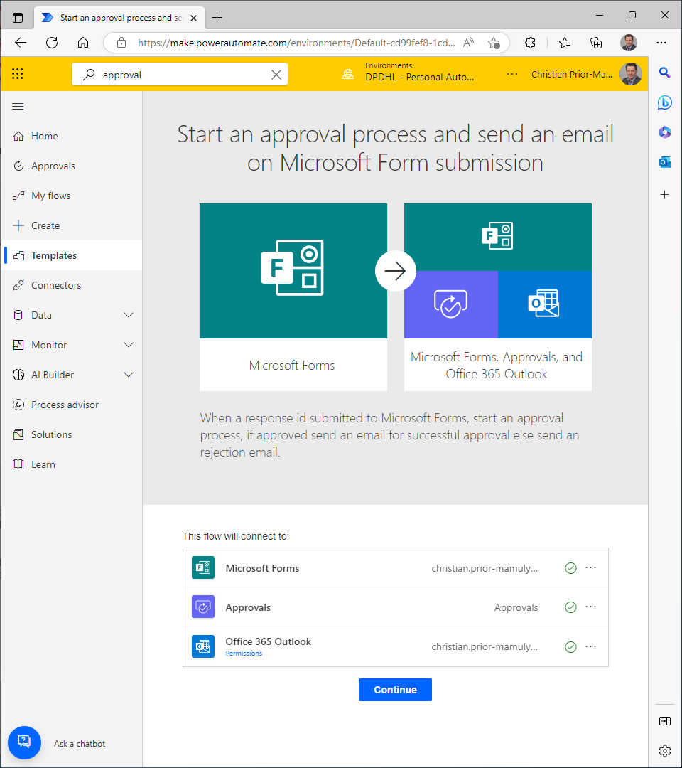
What are Cloud Flows?
Power Automate is a service that you can use to automate repetitive tasks to bring efficiencies to any organizations.
You can create cloud flows, desktop flows, or business process flows.
Cloud Flows may be Automated, Instant or Scheduled
Notes:
Planned duration: 2min
With Cloud Flows, you can automate tasks like sending emails, creating tasks, and updating data in response to triggers or events, such as when a new record is created in a database or when an email is received. You can also connect to a variety of cloud-based services, including Microsoft Dynamics 365, SharePoint, OneDrive, and Microsoft Teams.
Cloud Flows use a visual interface that enables users to create workflows without having to write any code. This makes them accessible to a wide range of users, from business analysts to IT professionals. You can also use advanced options like conditional logic, loops, and branching to create more complex workflows.

Slide 9
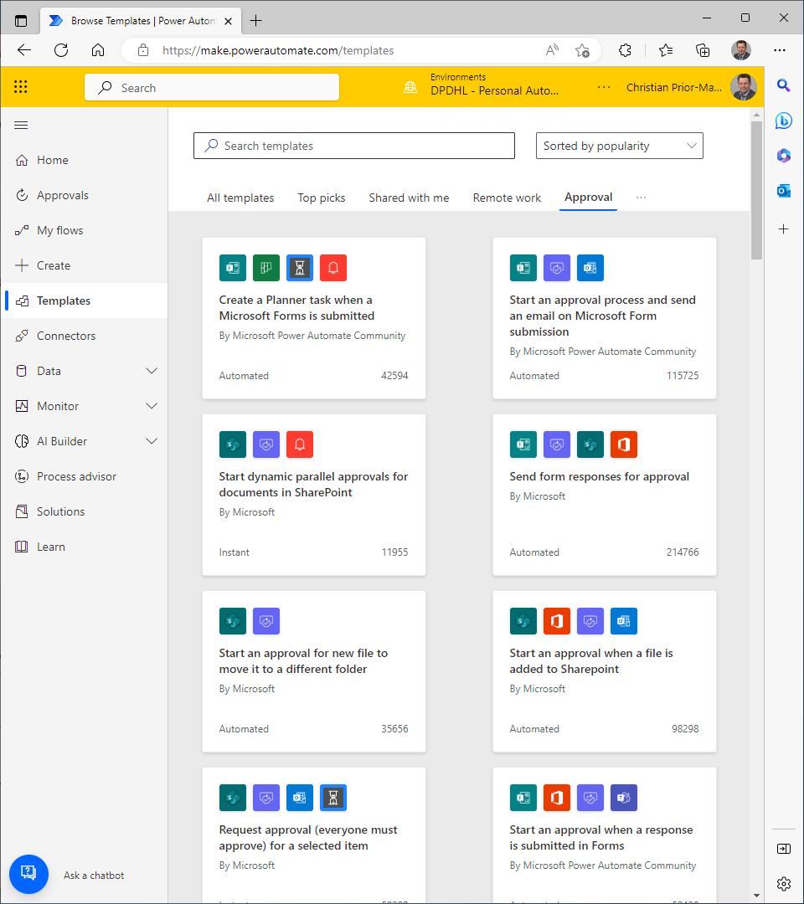
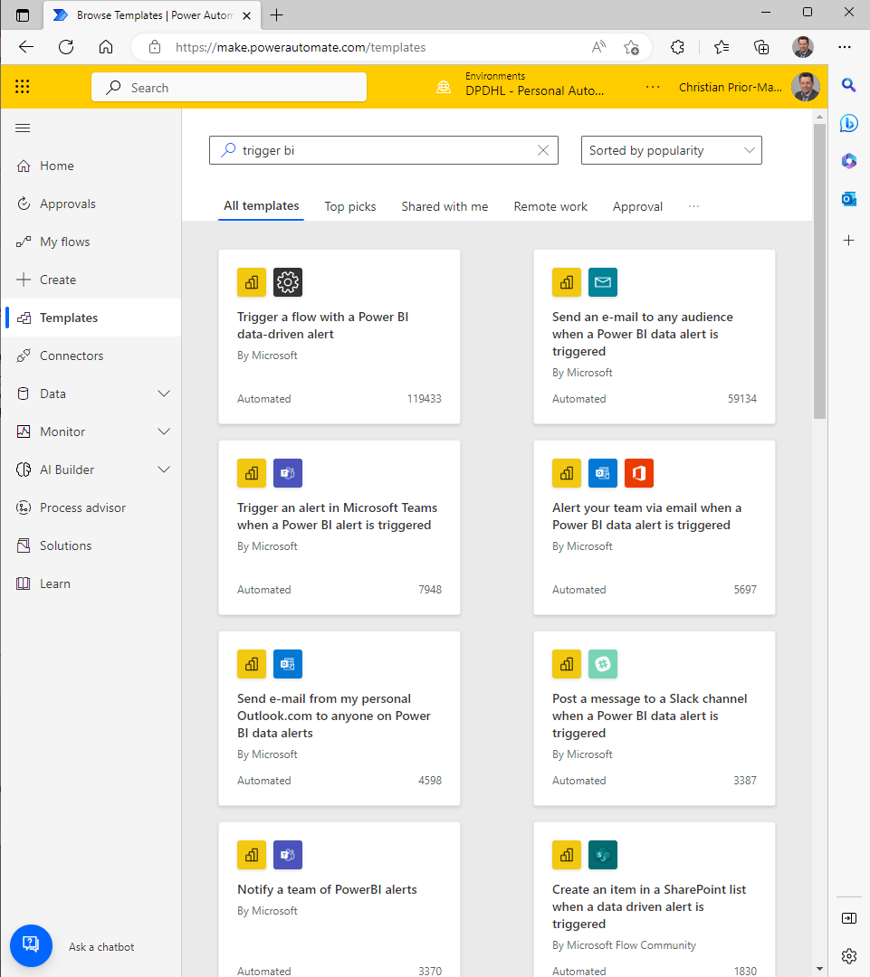
What are Cloud Flows suited for?
Get inspired by the templates
Notice the User profile picture: Power Automate has easy access to basic Azure Active Directory information. So usecases with „people picker“ are well-suited!
Explore the templates! Within the Microsoft 365 ecosystems many triggers can start a flow.
The transaction frequency should not be high (more on request limits in later slides)
The approval connector provides a great workflow automation, @see: https://learn.microsoft.com/en-us/connectors/approvals/
Notes:
Planned duration: 2min
Triggers: The Power Platform offers a variety of triggers that can be used to initiate cloud flows or canvas app workflows. These include scheduled triggers, manual triggers, and event-based triggers. Event-based triggers can be based on data changes in Microsoft 365, Dynamics 365, or other systems, as well as on custom events generated by third-party systems.
Active Directory Integration: The Power Platform offers deep integration with Active Directory, allowing you to easily manage access to your apps and flows. You can use Active Directory groups to assign permissions and roles to users, and you can also use Active Directory to authenticate users and enforce security policies.
Transaction Frequency: The Power Platform can handle a wide range of transaction frequencies, depending on your needs. For example, you can configure cloud flows to run on a schedule, such as once per day or every hour, or you can configure them to run in real-time based on data changes or other events.
Approvals: The Power Platform offers a built-in approvals system that can be used to manage approval processes for a variety of use cases. You can configure approval workflows to require one or more approvers, and you can also set up automatic reminders and escalations to ensure that approvals are completed in a timely manner.

Slide 10
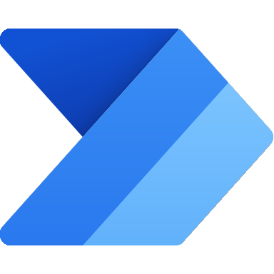
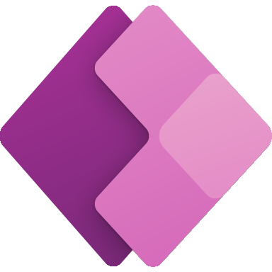
Which use cases are a good fit; when to avoid
Cloud Flow Strengths
Automating repetitive tasks
Integrating data across systems
Notification and alerts
Approval processes
Custom business processes
Cloud Flow Weaknesses
High-volume data processing
Complex business logic
Real-time processing
Custom integrations
Canvas App Strengths
Customized data entry forms
Standard data visualization
Workflow automation
Mobile apps
Custom business applications
Canvas App Weaknesses
Complex data relationships
High transaction volume
Advanced user interface requirements
Offline access
Notes:
Plan duration: 2min
The Microsoft Power Platform provides a range of tools for building custom business applications, including canvas apps and cloud flows. Here are some examples of good use cases for these tools:
Canvas App:
Customized data entry forms: Canvas apps are great for building customized data entry forms that can streamline data capture and improve accuracy. For example, you could create a canvas app for field technicians to use in the field that captures data such as work orders, time spent on a job, and materials used.
Real-time dashboards: Canvas apps can be used to create real-time dashboards that display key business metrics and KPIs. For example, you could build a canvas app that displays sales performance data from Dynamics 365, and update it in real time as new data becomes available.
Mobile apps: Canvas apps are ideal for building mobile apps that can be used by employees in the field or on the go. For example, you could build a mobile app that allows sales reps to access customer data and sales collateral from their smartphones.
Cloud Flow:
Workflow automation: Cloud flows can be used to automate a wide range of business processes, such as invoice processing, document approvals, and new employee onboarding. For example, you could build a cloud flow that automatically creates a new employee record in Dynamics 365, sends an email notification to HR and IT teams, and creates a task for the new employee's manager to set up a welcome meeting.
Data integration: Cloud flows can be used to integrate data between different systems and applications, such as syncing customer data between Dynamics 365 and Mailchimp. For example, you could build a cloud flow that automatically adds new customers to a Mailchimp list when they are added to Dynamics 365.
Notification and alerting: Cloud flows can be used to trigger notifications and alerts based on specific events or conditions. For example, you could build a cloud flow that sends an email notification to a sales rep when a new lead is added to Dynamics 365, or a text message notification to a manager when an employee submits a time-off request.
Overall, the Microsoft Power Platform canvas app and cloud flow provide a powerful suite of tools for building custom business applications and automating workflows. The key is to identify the specific pain points and opportunities in your organization, and design solutions that meet those needs effectively.
----------------------------------------------------------------------------------------------------
While canvas apps in the Microsoft Power Platform can be used to solve many different business problems, there are certain use cases where they may not be the best fit. Here are a few examples:
Complex data relationships: If your data has complex relationships between tables, such as many-to-many relationships or complex aggregations, a canvas app may not be the best fit. In these cases, a model-driven app or custom development may be more appropriate.
High transaction volume: If you are dealing with high transaction volumes, such as millions of records or hundreds of thousands of users, a canvas app may struggle to handle the load. In these cases, custom development or more robust enterprise applications may be required.
Advanced user interface requirements: While canvas apps offer a lot of flexibility in terms of user interface design, they may not be able to meet all advanced requirements, such as complex visualizations or advanced animations. In these cases, custom development or more specialized tools may be required.
Offline access: If your users need to access data and functionality when they are offline or in areas with poor connectivity, a canvas app may not be the best fit. In these cases, a mobile application with offline capabilities or a custom development solution may be required.
Overall, canvas apps in the Microsoft Power Platform can be a powerful tool for building custom business applications, but it's important to carefully consider the specific use case and requirements before choosing this approach. In some cases, other tools or approaches may be more appropriate for meeting your business needs.
----------------------------------------------------------------------------------------------------
Microsoft Power Platform cloud flows are particularly well-suited for a variety of use cases, including:
Automating repetitive tasks: Cloud flows can automate repetitive tasks, such as data entry or file uploads, saving time and reducing errors. For example, you could build a cloud flow that automatically creates a new record in Dynamics 365 whenever a new customer email is received in Outlook.
Integrating data across systems: Cloud flows can integrate data across multiple systems, making it easier to share information and eliminate data silos. For example, you could build a cloud flow that updates a SharePoint list with data from a SQL Server database, ensuring that the data is always up-to-date.
Notification and alerts: Cloud flows can send notifications and alerts to users when specific events occur, such as a new lead being added to Dynamics 365. For example, you could build a cloud flow that sends an email notification to a sales representative whenever a new lead is added to Dynamics 365.
Approval processes: Cloud flows can automate approval processes, such as expense approval or change requests, streamlining workflows and reducing delays. For example, you could build a cloud flow that sends an approval request to a manager whenever an employee submits a vacation request.
Custom business processes: Cloud flows can be used to build custom business processes that meet specific organizational needs. For example, you could build a cloud flow that manages the onboarding process for new employees, including sending welcome emails, creating accounts in various systems, and scheduling training sessions.
Overall, cloud flows in the Microsoft Power Platform offer a lot of flexibility and customization options, making them a great fit for many different business use cases. The key is to identify the specific pain points and opportunities in your organization, and design solutions that meet those needs effectively.
----------------------------------------------------------------------------------------------------
While Microsoft Power Platform cloud flows are a powerful tool for automating and integrating business processes, there are some use cases where they may not be the best fit. These include:
High-volume data processing: If you need to process large volumes of data quickly, cloud flows may not be the best option. While cloud flows can handle moderate volumes of data, they may not be able to keep up with high-volume data processing tasks.
Complex business logic: If your business processes require complex decision-making or conditional logic, cloud flows may not be the best fit. While cloud flows offer some advanced branching and looping capabilities, they may not be able to handle extremely complex logic.
Real-time processing: If you need to process data in real-time or near real-time, cloud flows may not be the best option. While cloud flows can be triggered by real-time events, such as new data being added to a database, there may be some latency between the event and the flow being executed.
Custom integrations: If you need to integrate with a custom application or system that is not supported by the Power Platform, cloud flows may not be the best fit. While the Power Platform offers a wide range of connectors, there may be some integrations that require custom coding or third-party tools.
Overall, while cloud flows in the Microsoft Power Platform are a versatile tool for automating and integrating business processes, they may not be the best fit for all use cases. It's important to carefully evaluate your specific needs and requirements to determine whether cloud flows are the right solution for your organization.

Slide 11
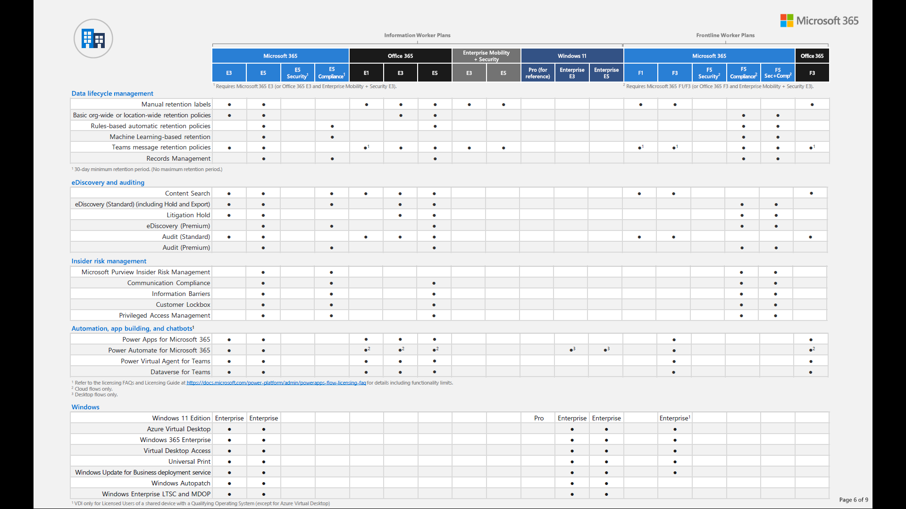
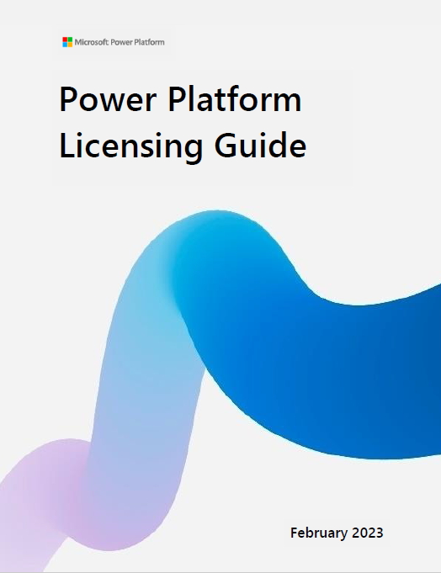
License Starting Point: Power Platform Capabilities in the Office 365 E3 License
On top of the entitlements included in the E5 license additional licenses are needed (see next slides).
Notes:
Planned duration: 0:02
Full comparison (PDF) https://go.microsoft.com/fwlink/p/?LinkID=2139145&clcid=0x409&culture=en-us&country=US
The Microsoft 365 E3 license includes a range of entitlements for the Power Platform, which allow users to create, customize, and automate business processes using Power Apps, Power Automate (formerly known as Flow), and Power BI. Here are some of the specific entitlements that are included in the Microsoft 365 E3 license:
Power Apps: With the E3 license, users can create and run canvas apps, which are custom applications that can be built without coding. Users can also access premium connectors, which enable integration with a wide range of data sources and services.
Power Automate: E3 users can create and run cloud flows, which are automated workflows that can be used to streamline business processes. E3 users can also access premium connectors and gateways, which enable integration with on-premises data sources and systems.
Power BI: E3 users can create and share interactive reports and dashboards using Power BI, which is a business intelligence and data visualization tool. E3 users can also access premium features such as data export and AI-powered insights.
In addition to these entitlements, E3 users also have access to Common Data Service, which is a cloud-based data storage and management platform that can be used to build custom data models and integrate with other Microsoft services. E3 users can also use Microsoft Dataverse, which is a low-code data platform that allows users to build custom business applications and automate workflows.

Slide 12
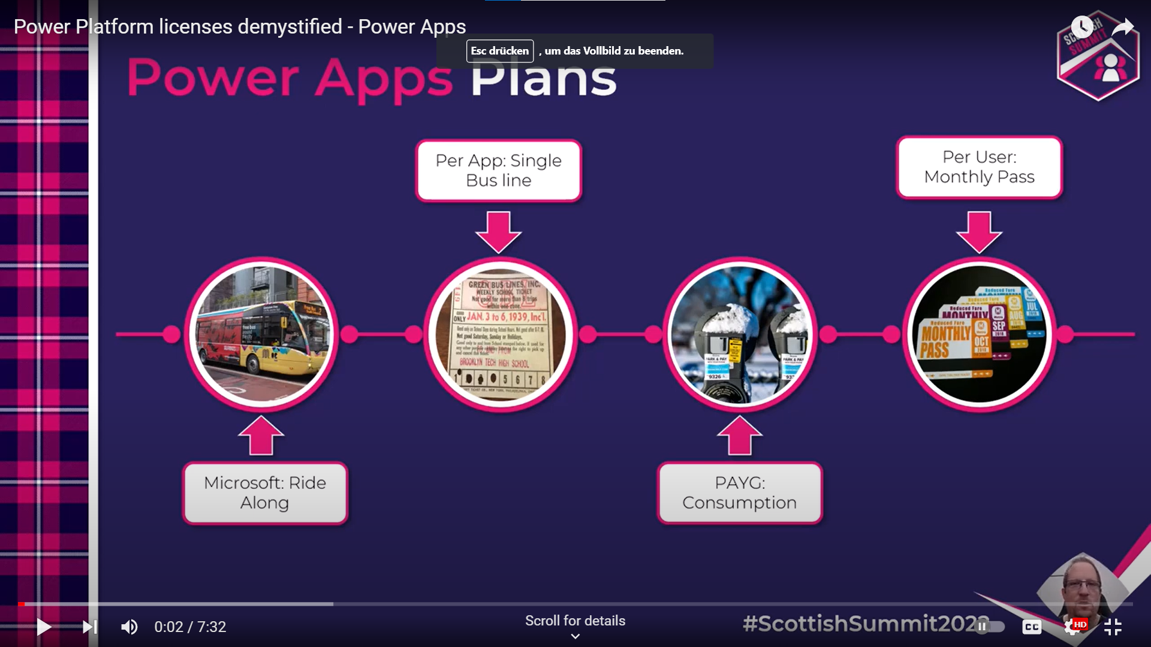
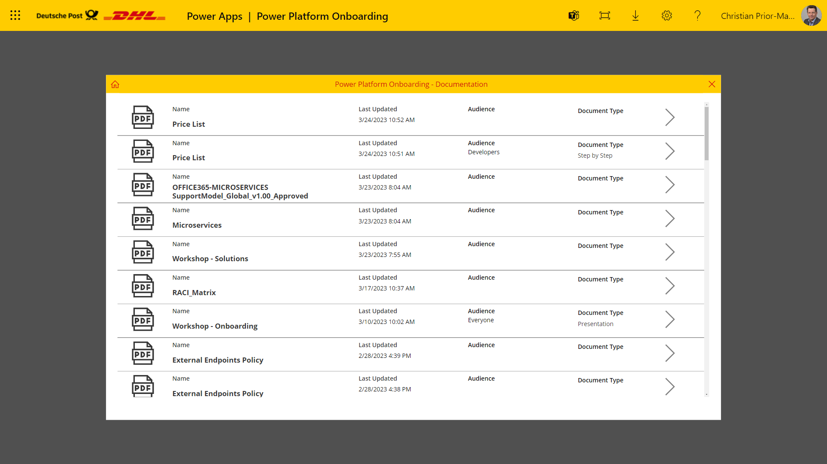
The MS Power Platform License Model, Explained by an Analogy
Source: Power Platform licenses demystified - Power Apps, Sep 13, 2022, https://www.youtube.com/watch?v=v4-4KlsZkkA
References
Personal Productivity
Per-App
Pay-as-you-Go
Per User
Notes:
Planned duration: 0:01
Rule of thumb:
4 per-app licenses equal 1 per-user license
the Power Apps per app plan provides a capacity to run apps and the management experience for this license is in the Power Platform admin center.
Power Platform Licensing Guide Feb 2023.pdf

